Slide 1
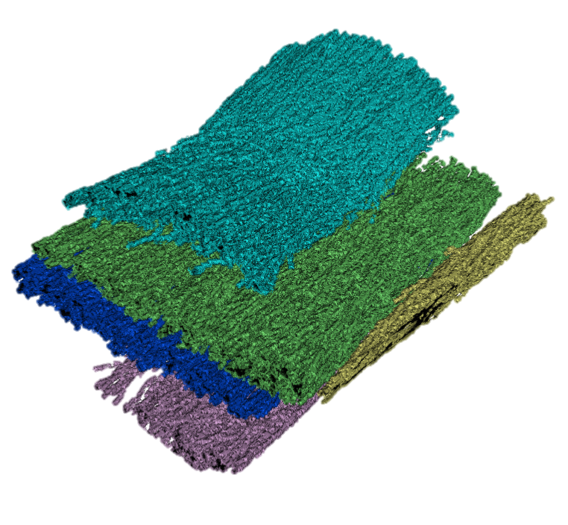
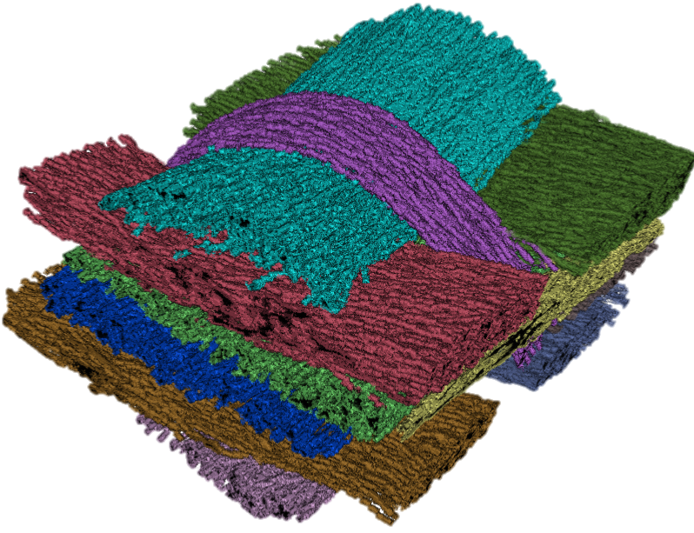
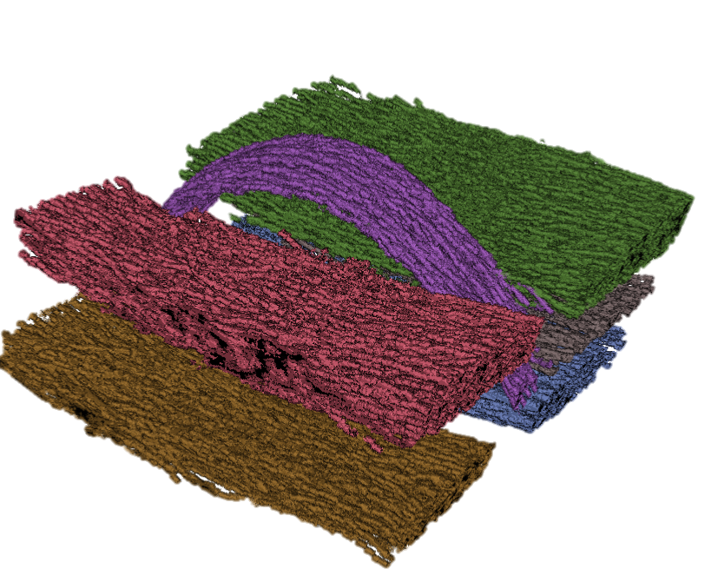

Clusters From Orientation 1
1
1
2
4
3
2
4
3
5
Clusters From Orientation 2
5
1
1
2
2
3
3
6
4
B
5
4
5
Combined clusters
6
A

Slide 2
Clusters From Orientation 1
1
1
2
4
3
2
4
3
5
Clusters From Orientation 2
5
A
B
Combined clusters

Slide 3
Clusters From Orientation 1
1
1
2
4
3
2
4
3
5
Clusters From Orientation 2
5
A
B
Combined clusters

Slide 4
Clusters From Orientation A
Clusters From Orientation B
1
1
1
1
2
2
2
3
3
6
3
2
4
4
3
4
5
5
4
5
5
6
A
Bundles per Orientation
A
B
Combined clusters

Slide 5
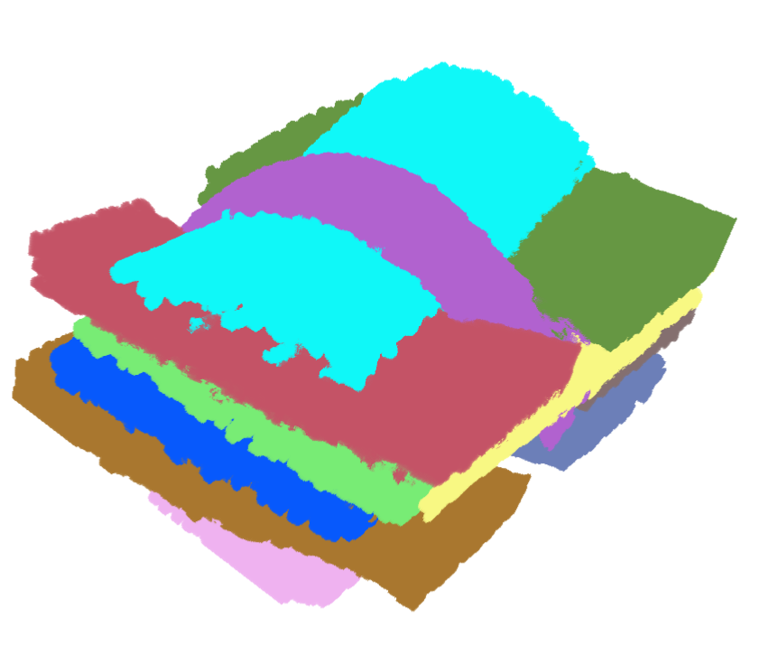
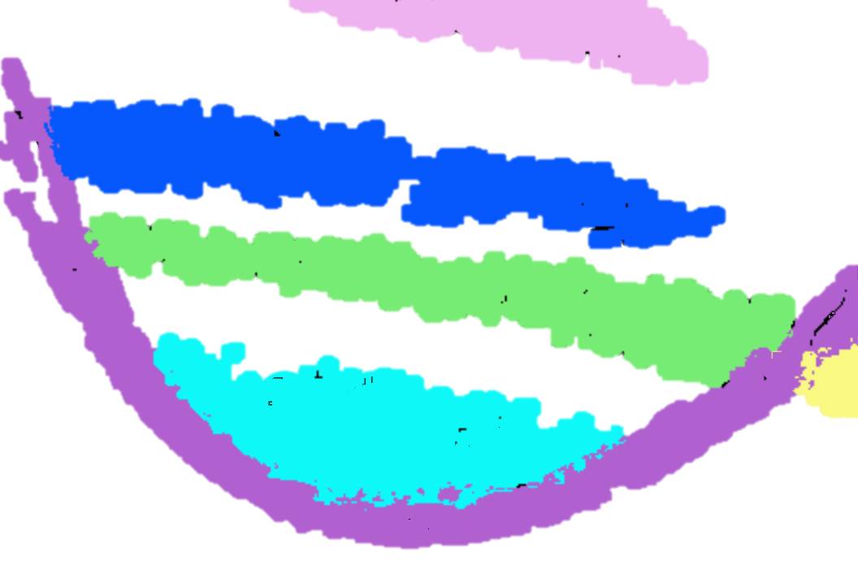
A
B
Fiber bundles volume
Single slice of volume

Slide 6
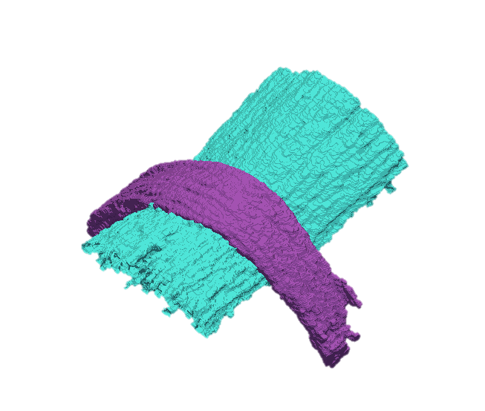
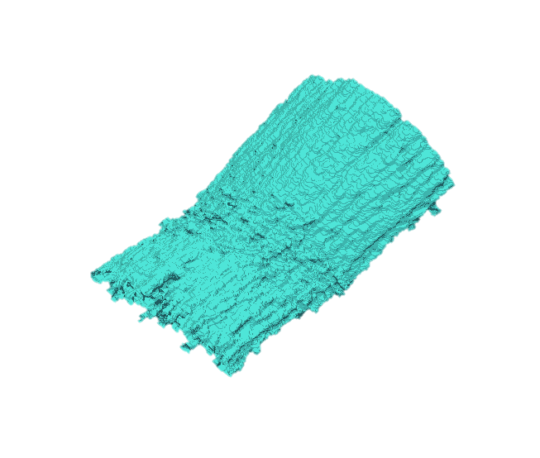
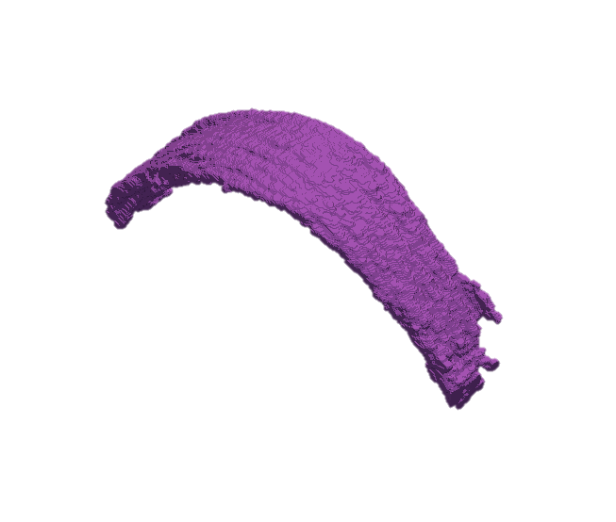
C
D
Fiber bundles volume
Single slice of volume
1
1
1
1
F
Individual surface mesh
E
Combined surface mesh

Slide 7
A
Fiber bundles volume
Single slice of volume
B
7
7
C
7
7
D
Individual surface mesh
Combined
surface mesh

Slide 8
A
Fiber bundles volume
Single slice of volume
B
C
7
D
Individual surface mesh
Combined
surface mesh

Slide 9
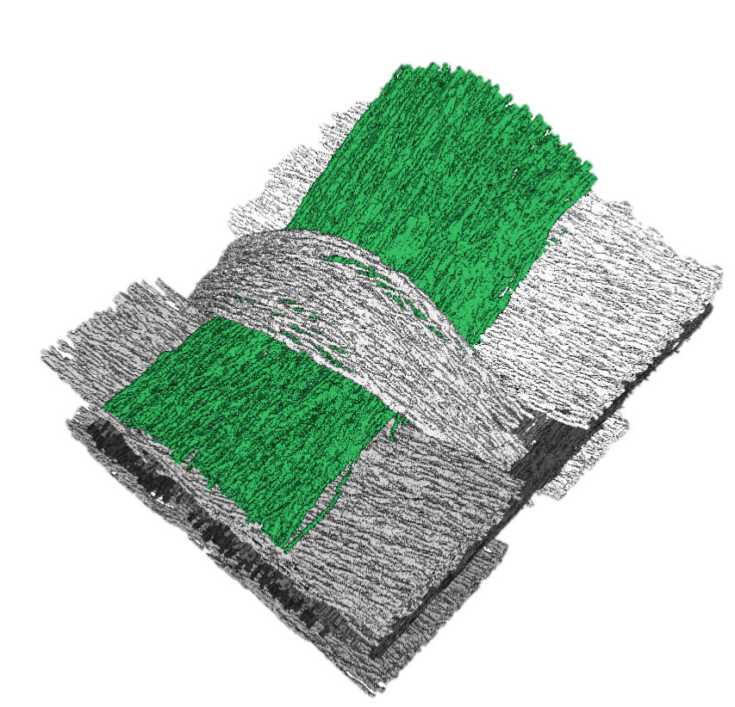
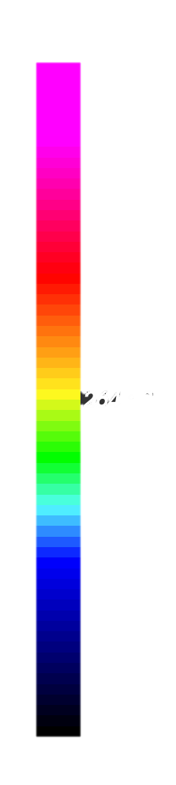
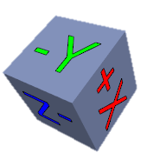
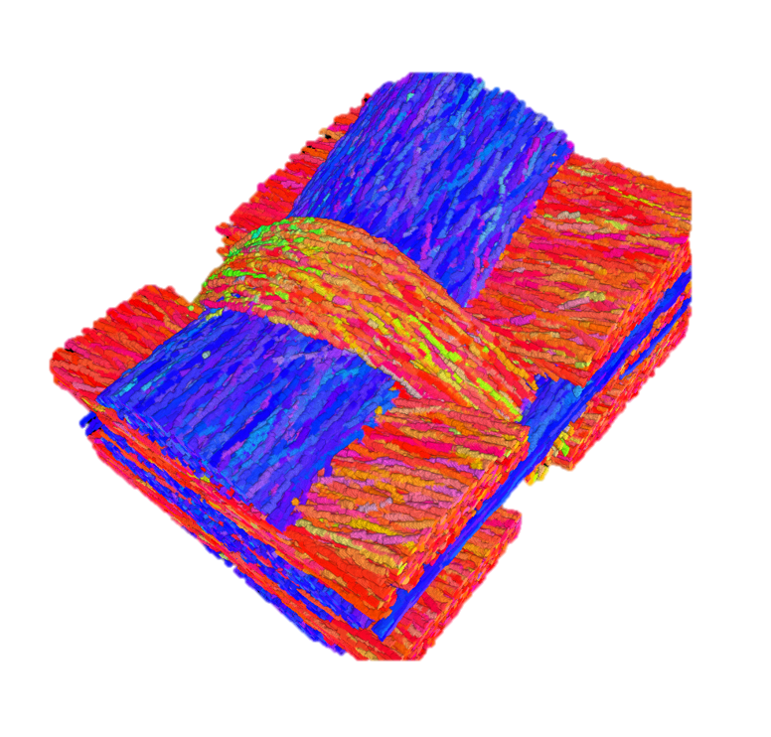
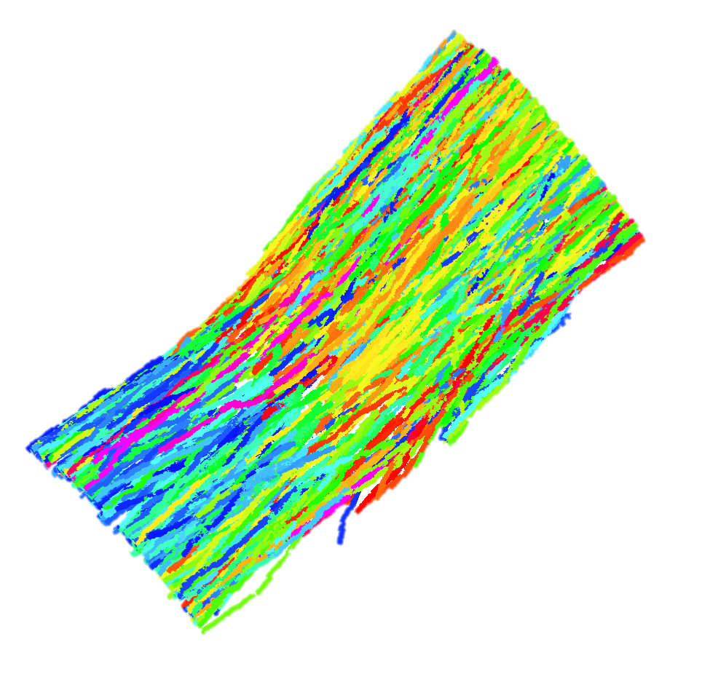
Length Distribution of fibers in bundle 1
MetaTracts color mapped to major axis direction
A
B
1
529
396
264
132

Slide 10
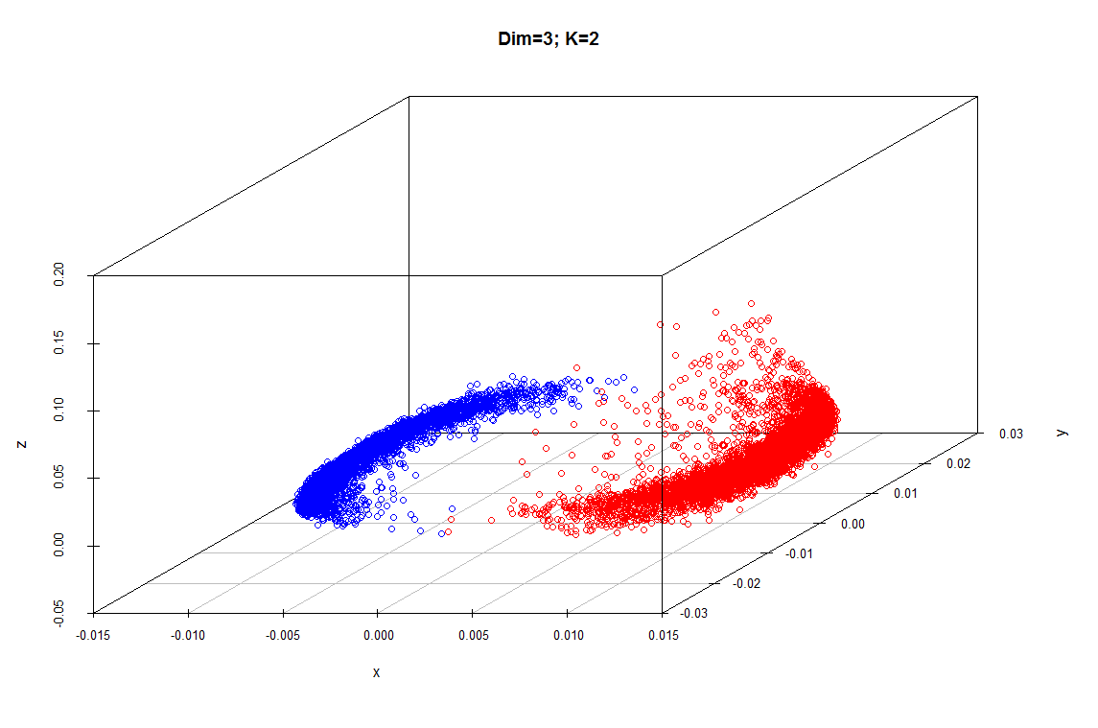
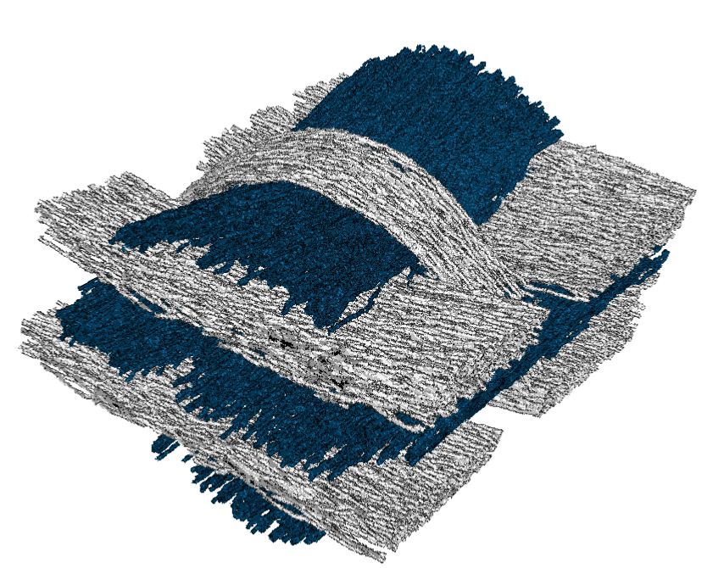
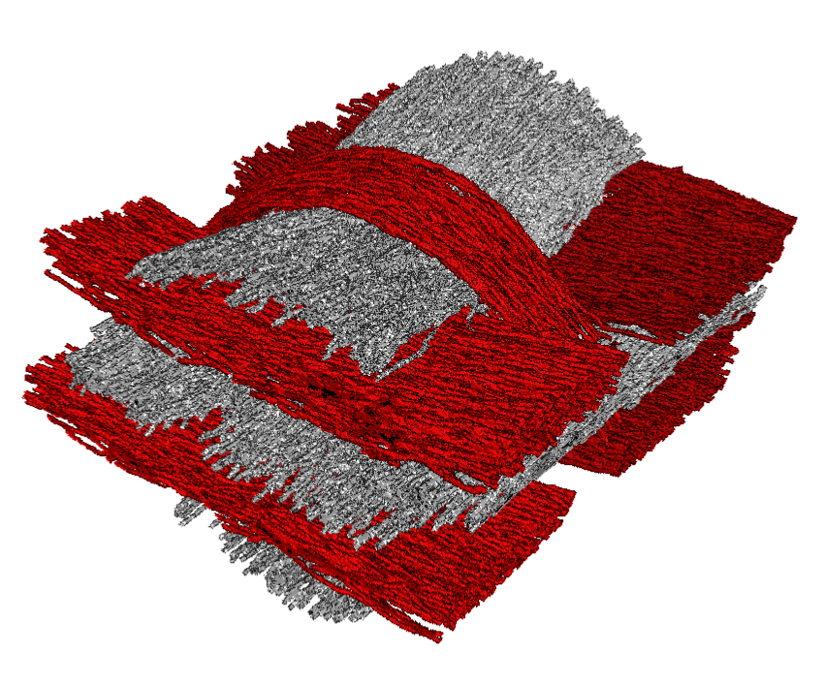
MetaTracts projected on top three eigenvectors and clustered into 2.
A
C
B
Eigenvector 3
Eigenvector 2
MetaTracts in
Cluster 2
MetaTracts in
Cluster 1
Eigenvector 1

Slide 11
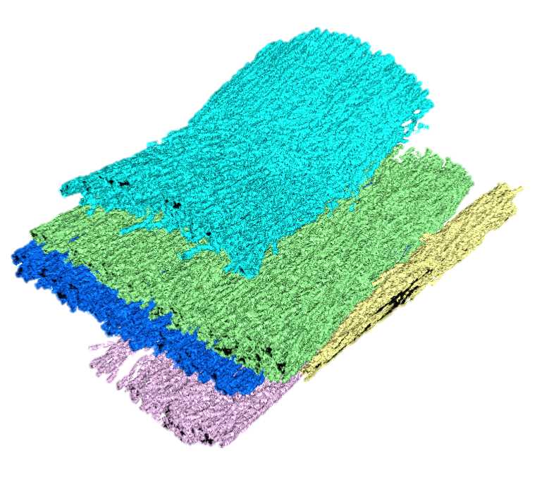
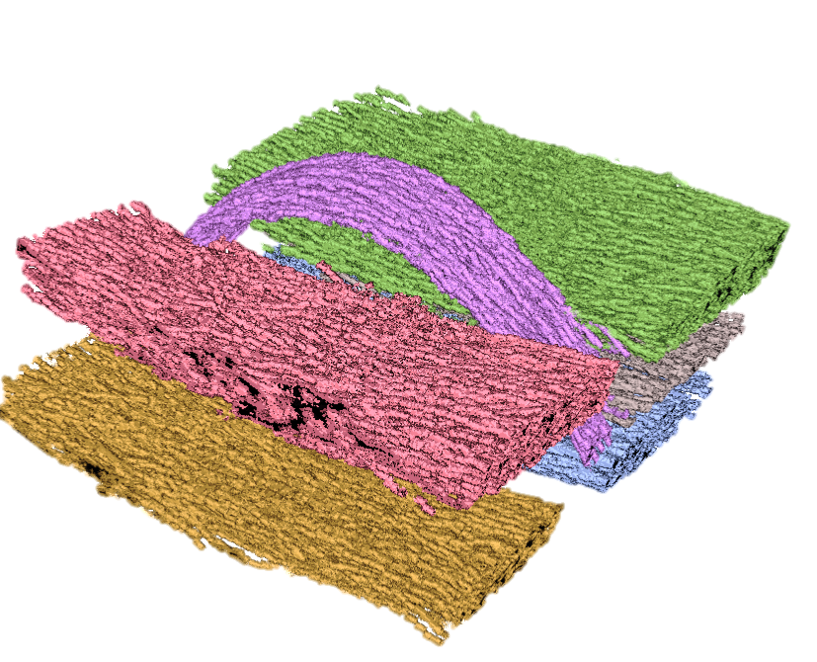
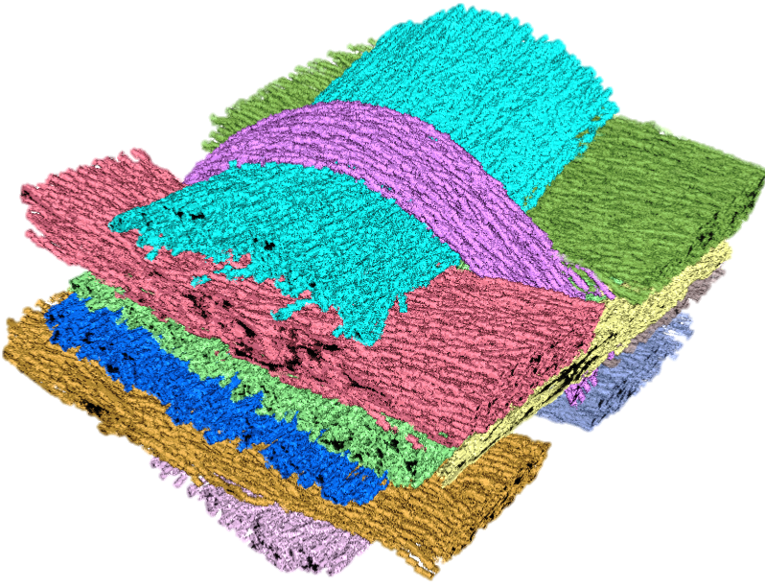
A
B
C
Eigenvector 3
Eigenvector 2
MetaTracts in
Cluster 1
MetaTracts in
Cluster 2
Eigenvector 1
MetaTracts projected on top three eigenvectors and clustered into 2.
D
E
7
1
5
2
6
8
3
9
4
11
10
F

Slide 12
A
B
C
Eigenvector 3
Eigenvector 2
MetaTracts in
cluster 1
MetaTracts in
cluster 2
Eigenvector 1
MetaTracts projected on top three eigenvectors and clustered into 2.
D
E
7
1
5
6
2
8
3
9
4
11
10
F

Slide 13
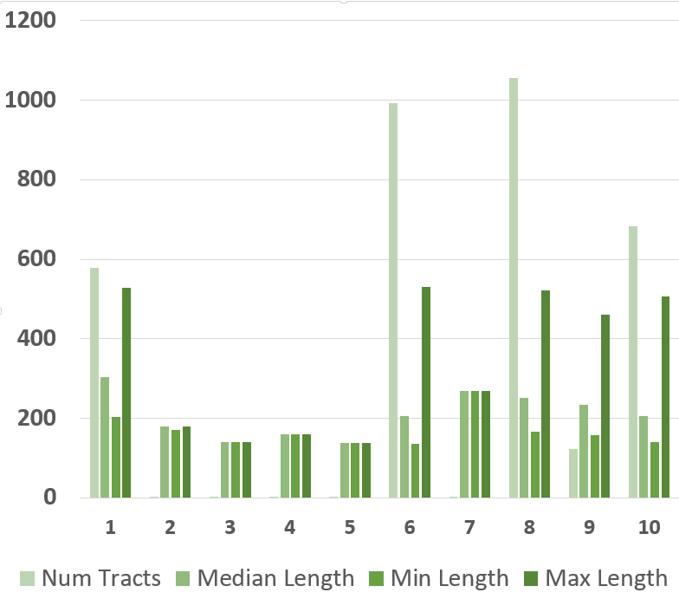
6
8
9
10
1
X Axis : Fiber Bundle clusters of orientation A. Unit for length is unit cube length.

Slide 14
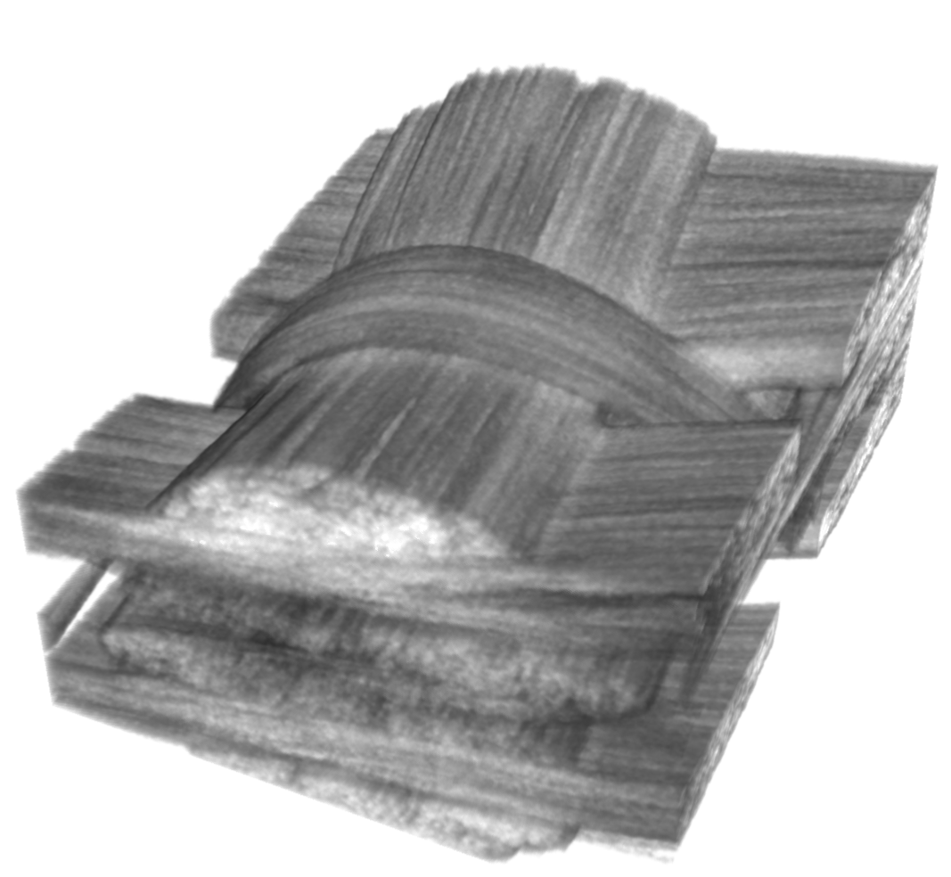
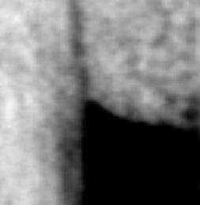
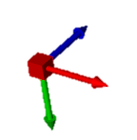
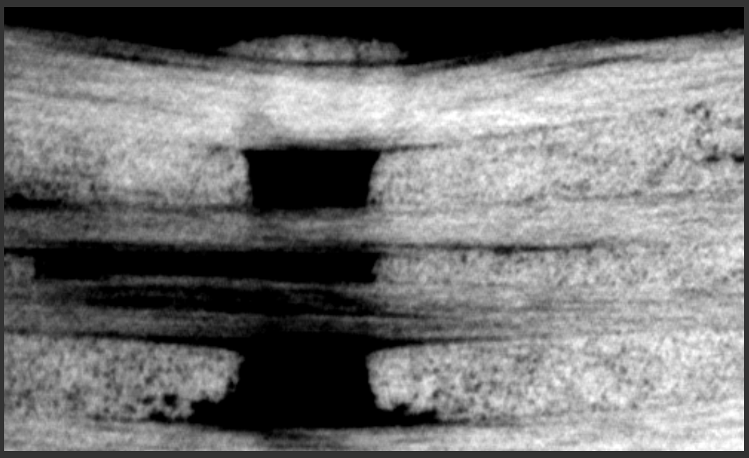
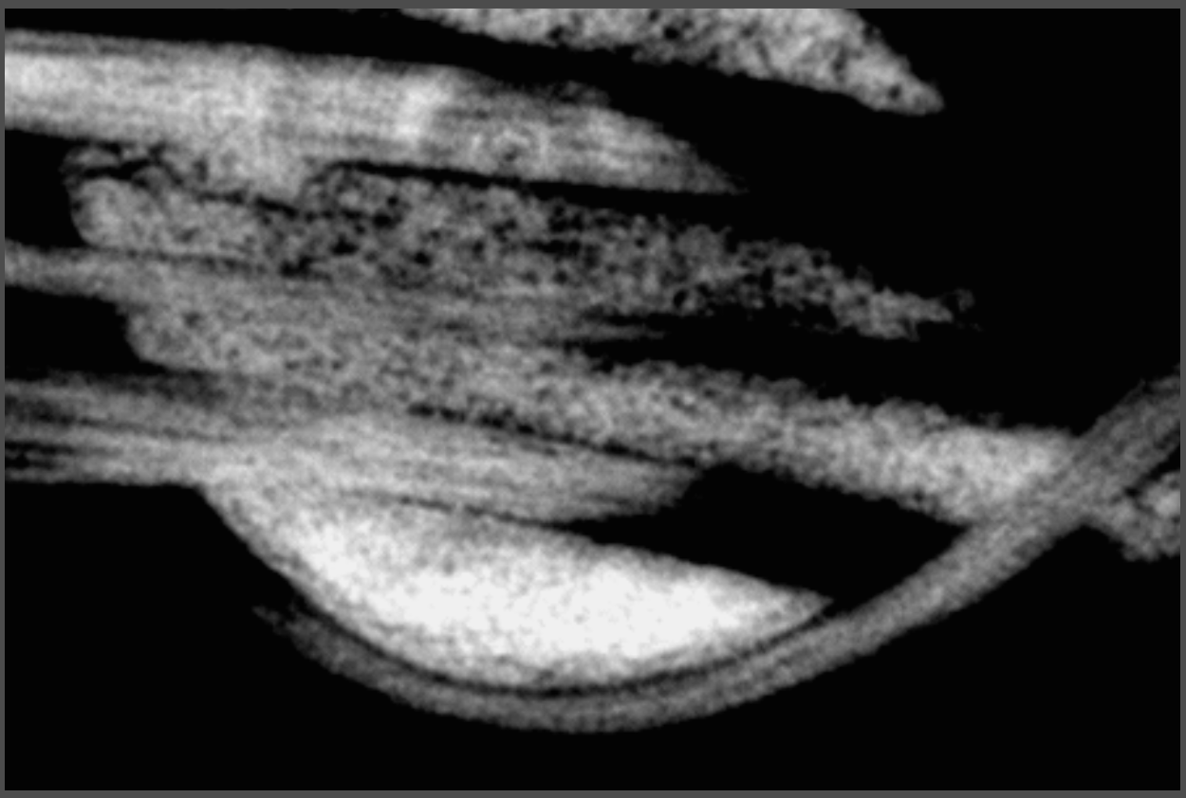
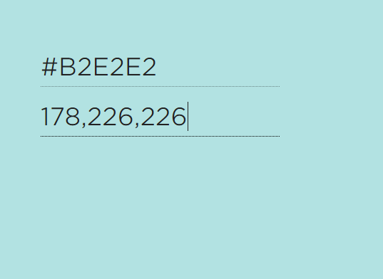
A
Y Z Plane
D
X Y Plane
X axis
B
C

Slide 15
A
Y Z Plane
D
X Y Plane
X axis
B
C

Slide 16
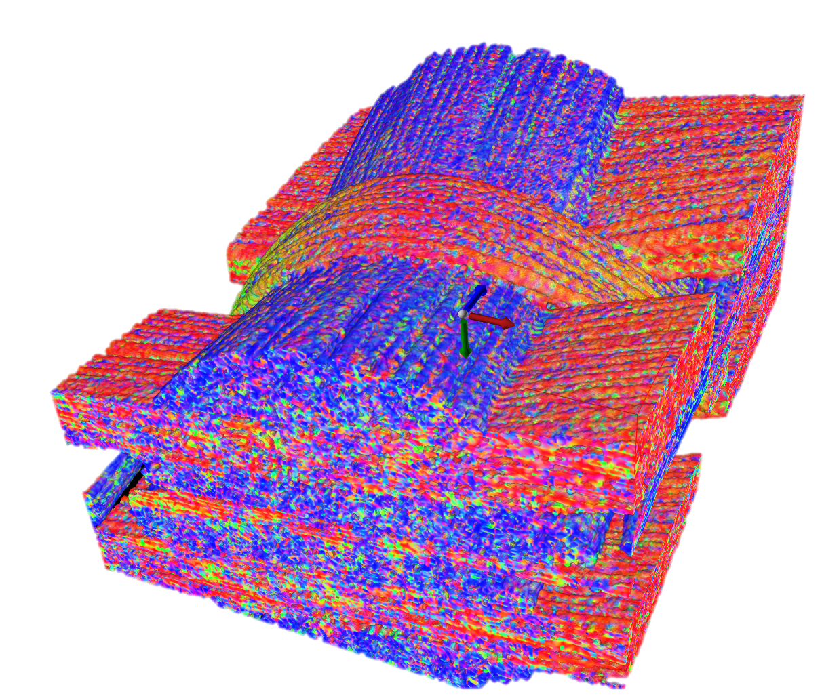
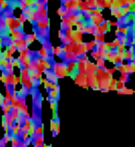
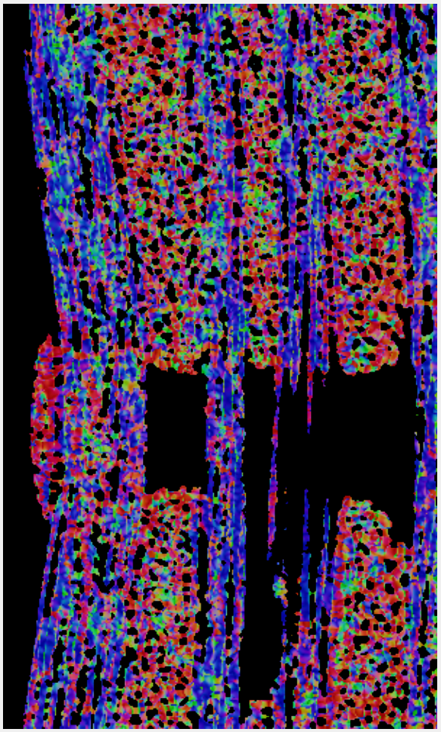
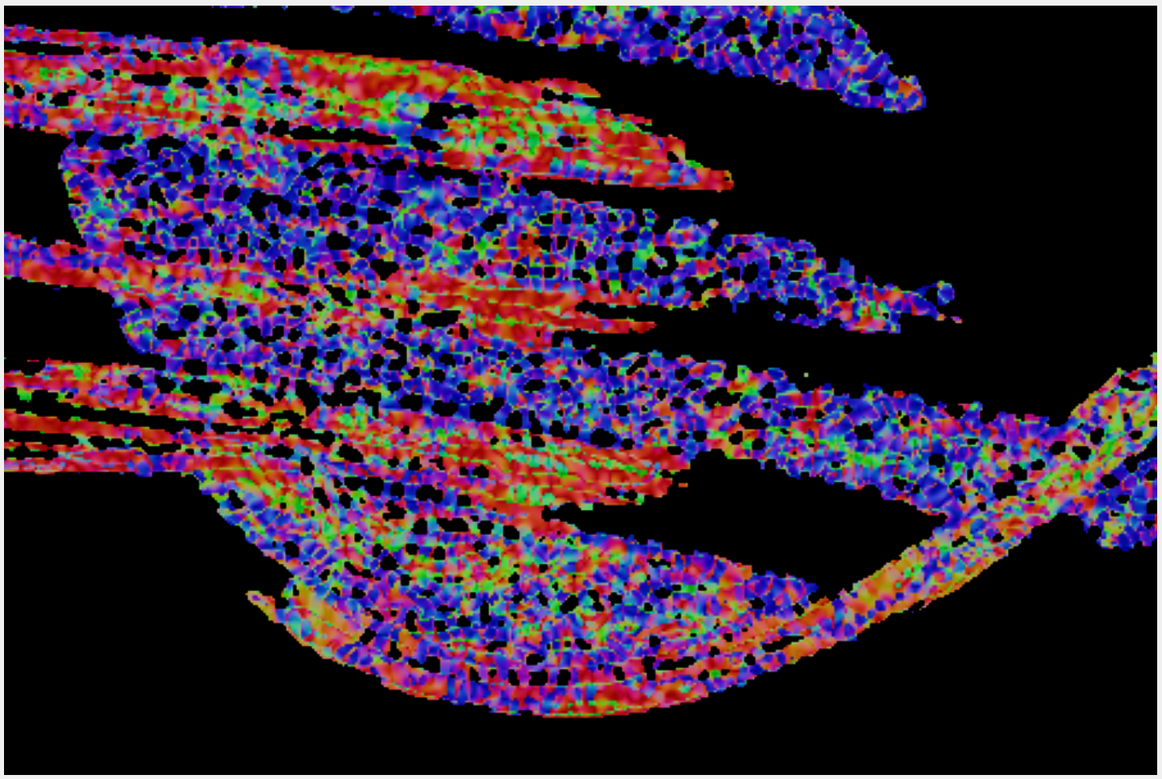
A
Y Z Plane
D
X Y Plane
B
C

Slide 17
A
Y Z Plane
D
X Y Plane
B
C

Slide 18
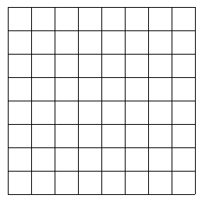
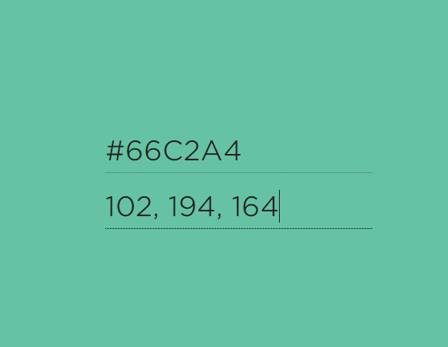
A
2R
N_{P}
L
C_{P}
Dist
B
C

Slide 19
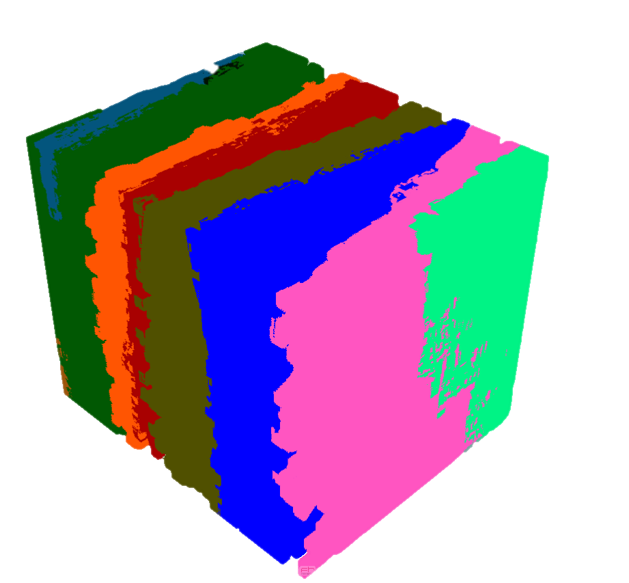
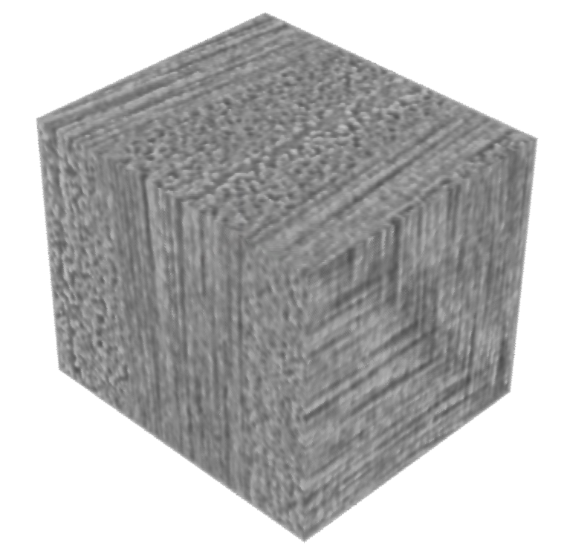
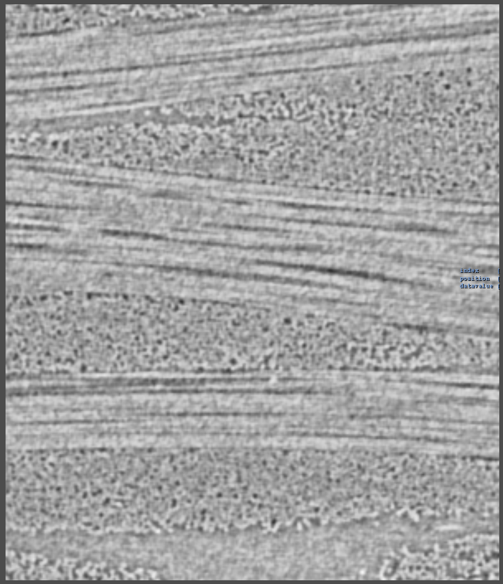
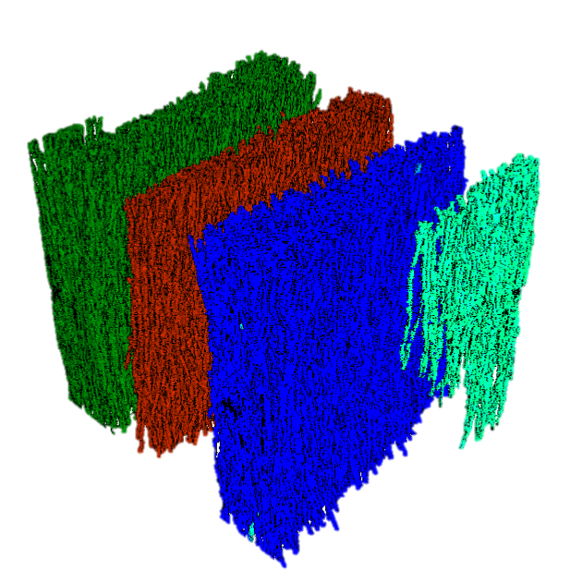
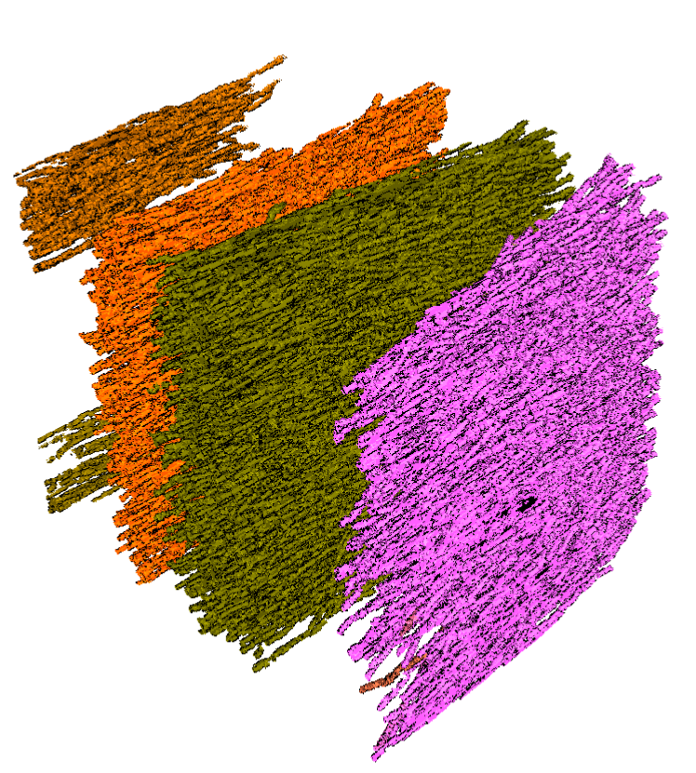
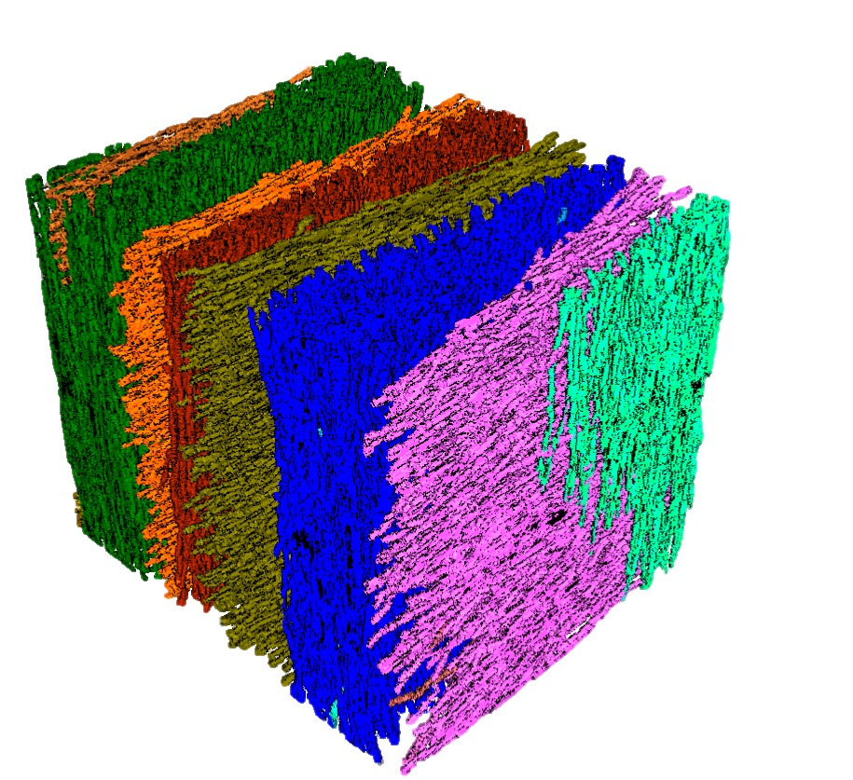
Scalar Data
Volume Visualization
A
D
B
C
Individual Orientation clusters
Combined clusters

Slide 20
A
Scalar data
D
Volume visualization
B
Individual orientation clusters
C
Combined clusters

Slide 21
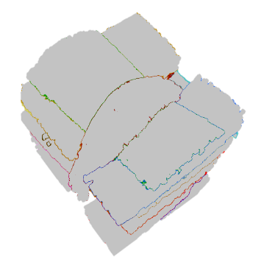
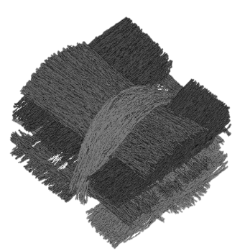
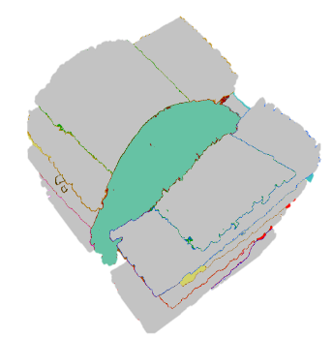



XCT data
Reliable Hessian
MetaTracts
Generation
Fiber Bundle Generation
Calculations
Scalar Data
Visualization

Slide 23
